Slide 1
BALOCH INTERPRISES
FINANCIAL OVERVIEW

Slide 2

FINANCIAL ANALYSIS
Financial process is the evaluation of the business, project, budget or finance related transactions.
Our company has a proper investment set-up and have a daily investment return and we are hitting the trends in market according to our average and standard deviation.

Slide 3
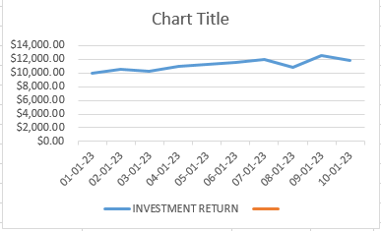
LINE CHART OF OUR PROGRESS

Slide 4
Overview of key financial metrics and investment strategies.
We will increase our investment so that we can become one of the top companies in the market.
We will increase our average.
We will increase our standard deviation.

